Slide 1

Data Analytics Associate final project SUBMISSION Diabetes Disease Prediction
SUBMITTED BY:
NAME: KILLANA PAVAN KUMAR
ENROLLMENT NO:EBEON0322583426
BATCH NO: 2021-7233
CENTRE NAME: BANGALORE-EXL
GUIDED BY: KARTHICK SIR
FROM: EDUBRIDGE INDIA.COM

Slide 2
Contents:
Aim of the Project
Introduction
Motivation
Objectives
Data Preprocessing
Exploratory Data Analysis
Data Visualization
Tools and Models used
Output Values
Conclusion

Slide 3
Aim of the project:
To predict Diabetes disease among different people using multiple Machine Learning Classification models and developing a intelligent system to classify patients and predicting the disease correctly based on their accuracy score.

Slide 4
Introduction:
Diabetes , is a group of metabolic disorders in which there are high blood sugar levels over a prolonged period.
Symptoms of high blood sugar include frequent urination , increased thirst and increased hunger.
If left untreated, diabetes can cause many complications. Acute complications can include diabetic ketoacidosis, hyperosmolar hyperglycemic state , or death.
Serious long-term complications include cardiovascular disease, stroke, chronic kidney disease, foot ulcers and damage to the eyes.

Slide 5
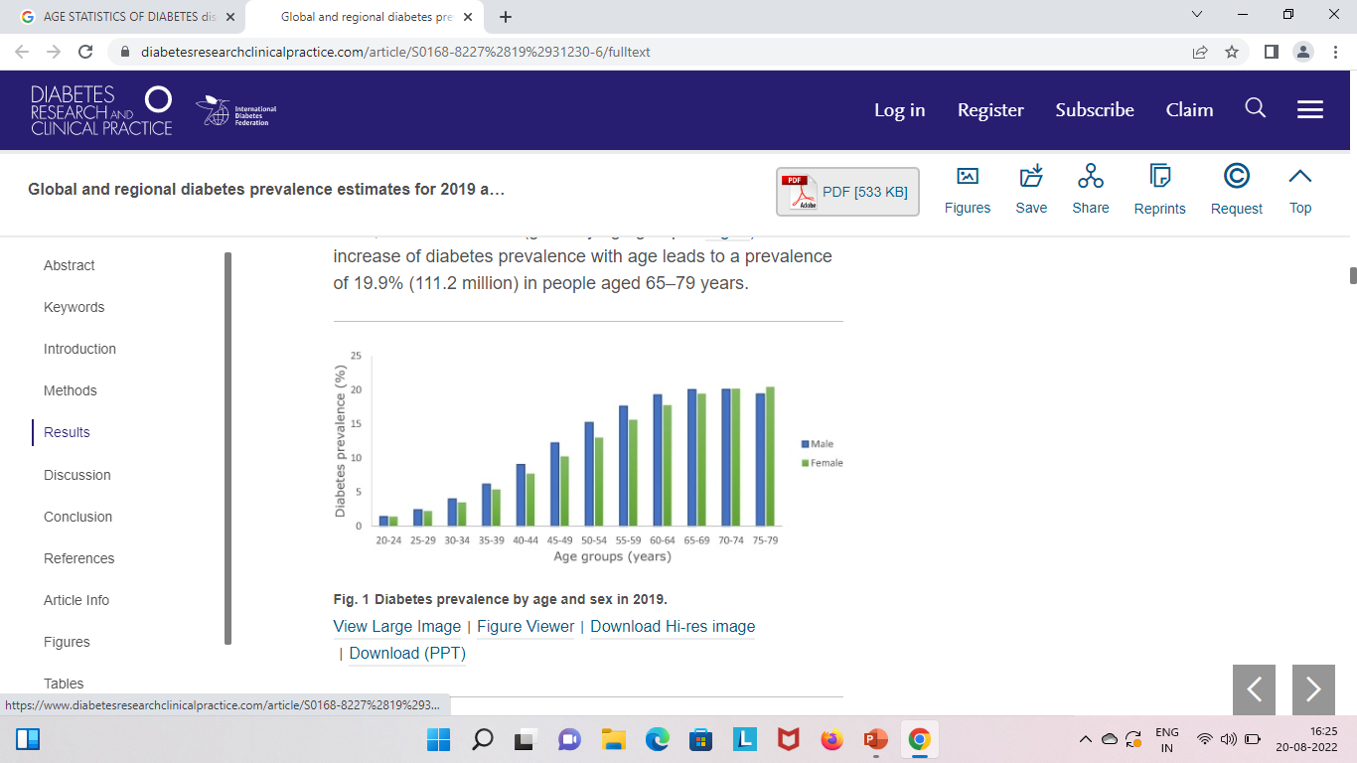
Motivation:
Diabetes is the most frequent and rapidly growing diseases worldwide.
People with ages in the range from 20 to 80 years are at high risk of being impacted by diabetes.
About 465 million grown-ups are affected by this disease which increases to 700 million by 2045.
High mortality rate because of other severe complications and delayed diagnosis increases the death rates.

Slide 6
Future scope of the project:
To develop a intelligent system to classify patients based on their accuracy score in predicting the disease.
To contribute in Medical sector and to reduce the cost of overall clinical analysis.
Diagnose patients in early stages .
Reduce mortality rate.
To employ our proposed model which will produce better performances than the previously existing ones.

Slide 7
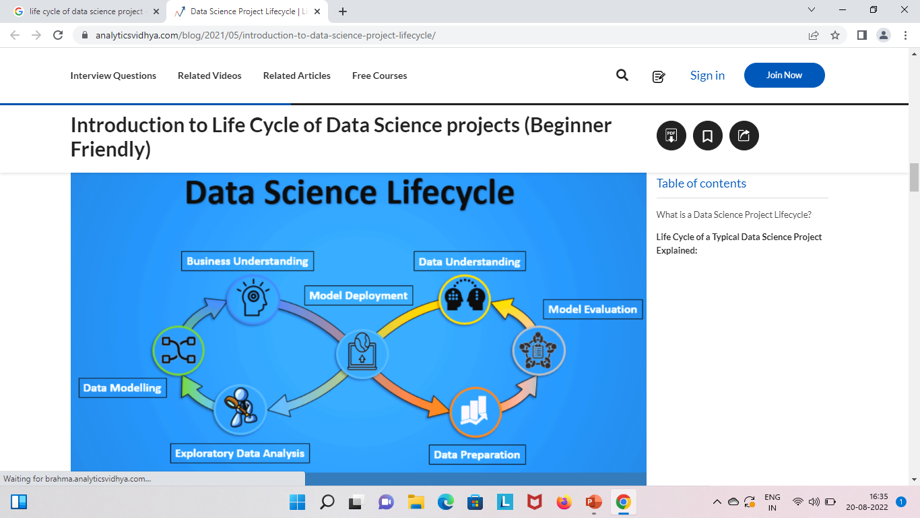
Objectives:

Slide 8
Data preprocessing:
The original Dataset was taken from Kaggle website it was proposed by Franks.
The dataset is involved into the analysis of patients suffering from diabetes disease.
The class imbalance problem is handled by assigning class weights(say Class 0:0.56,Class 1:0.44) to the classes using scikit-learn tool.
This dataset consisting of no null values and some columns with zero values has been replaced by mean/average of their particular column.
Here we have taken output named column as dependent variable and remaining columns as independent variable in preparing the data.

Slide 9
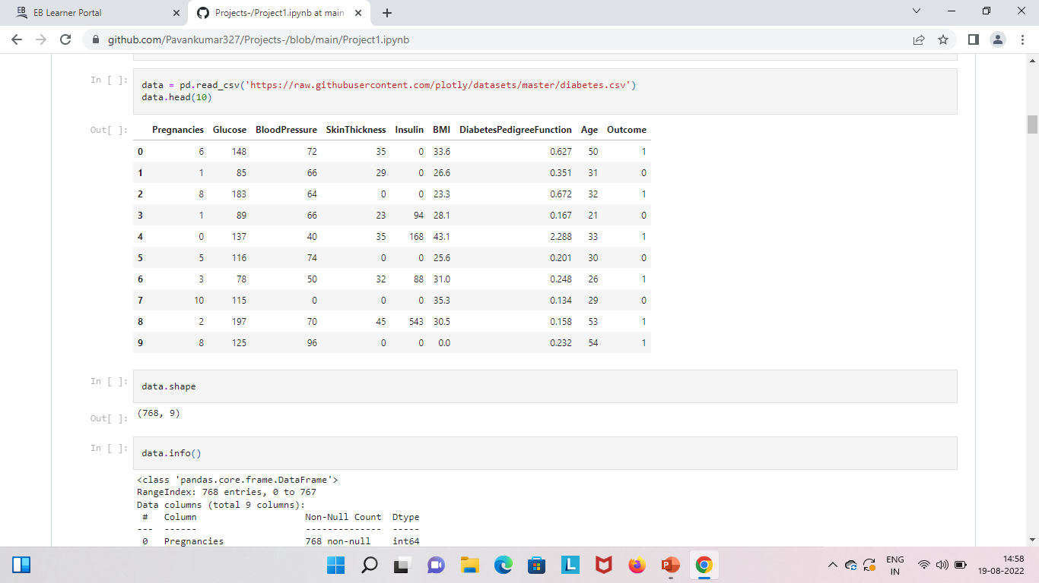
Dataset of the project:

Slide 10
Exploratory data analysis:
With Exploratory data analysis we can able to understand our data in better way.
Here we can find out data distribution, relationship between the variables.
Also we have performed various visualization plots in finding the relationship between them like histogram ,point plot, scatter plot, box plot, regression plot etc.

Slide 11
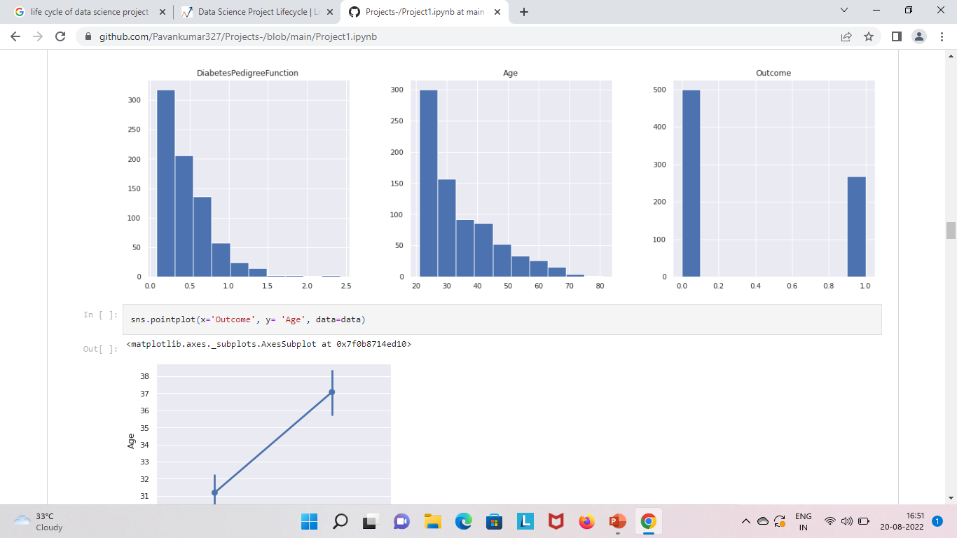
Data visualization:

Slide 12
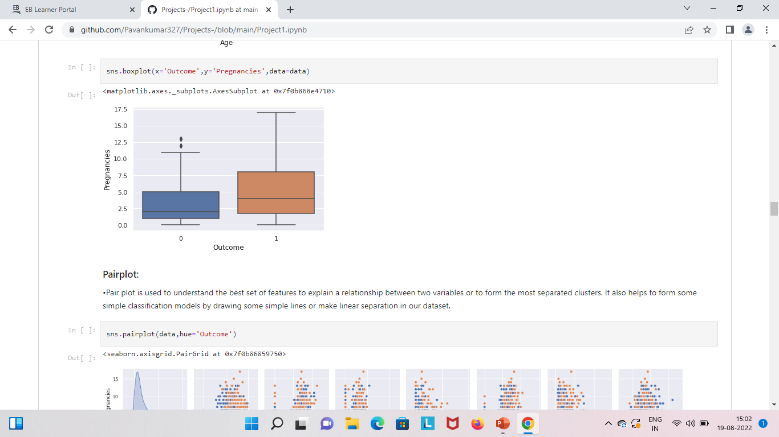
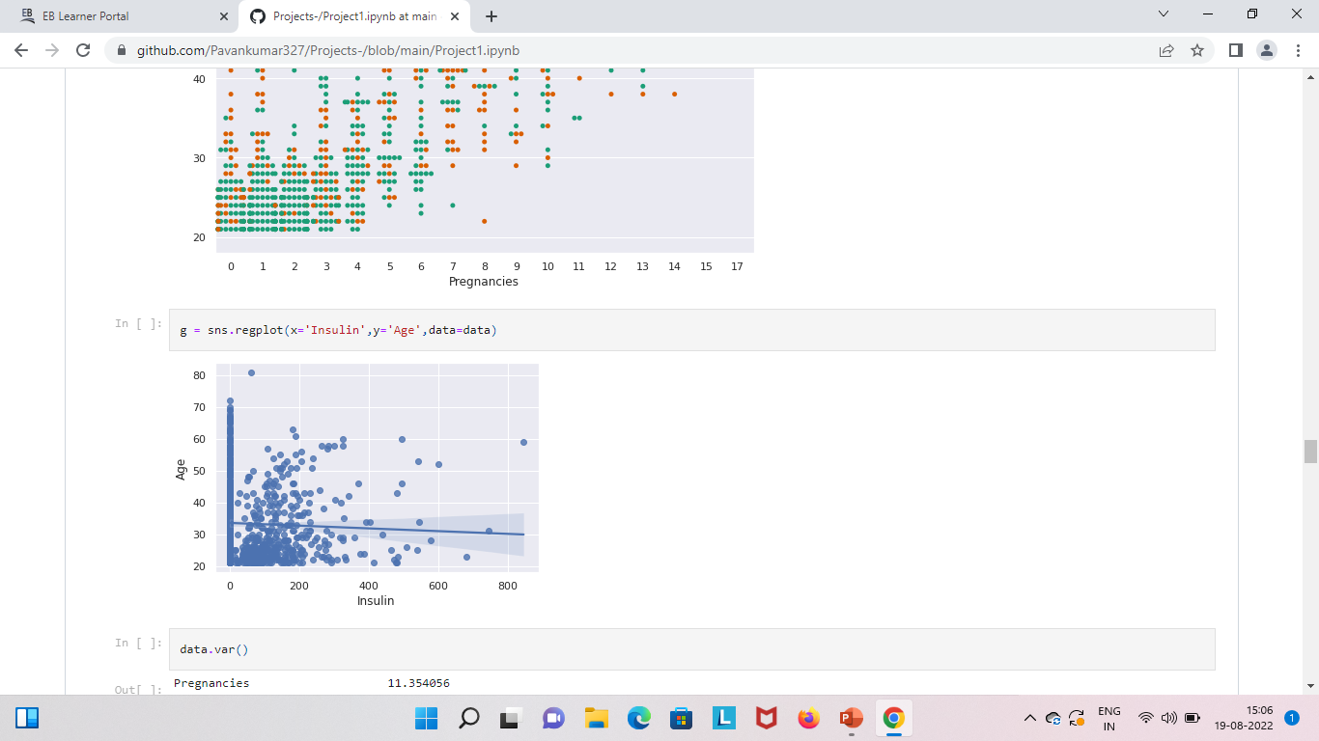

Slide 13
Tools and models used:
Tools used: Python programming language, Google colab website, Classification Machine Learning Algorithms, Scikit-learn, numpy ,pandas, matplotlib , seaborn etc.
Models used: 1.Logistic Regression
2.K-NearestNeighbours
3.SVC
4.Decision Tree Classifier
5.Gradient Boosting Classifier
6.Stacking
Stacking is the ensemble technique, in this two or more classifiers act as base model and the prediction of those will be the x value for the other model(i.e. meta-data).

Slide 14
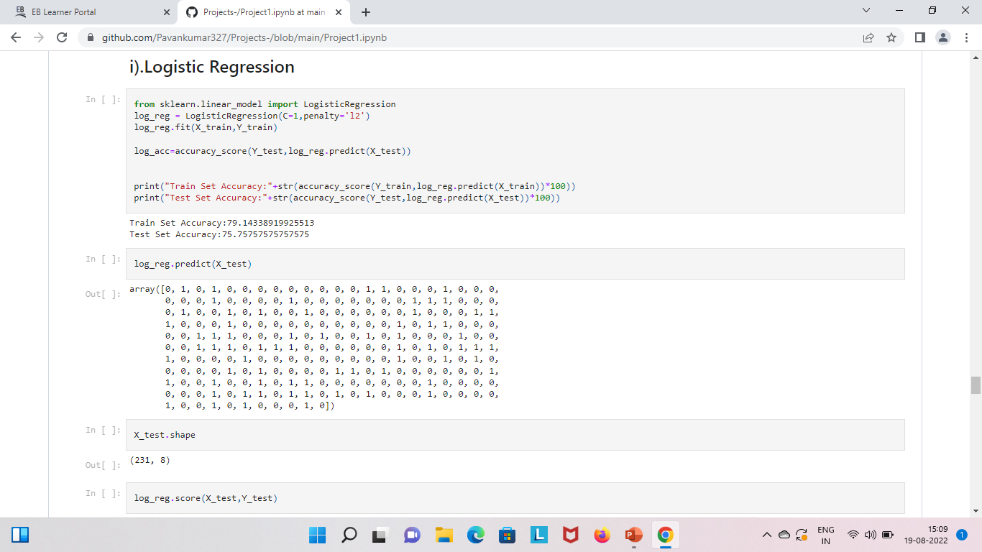
Accuracy score of multiple ml models:

Slide 15
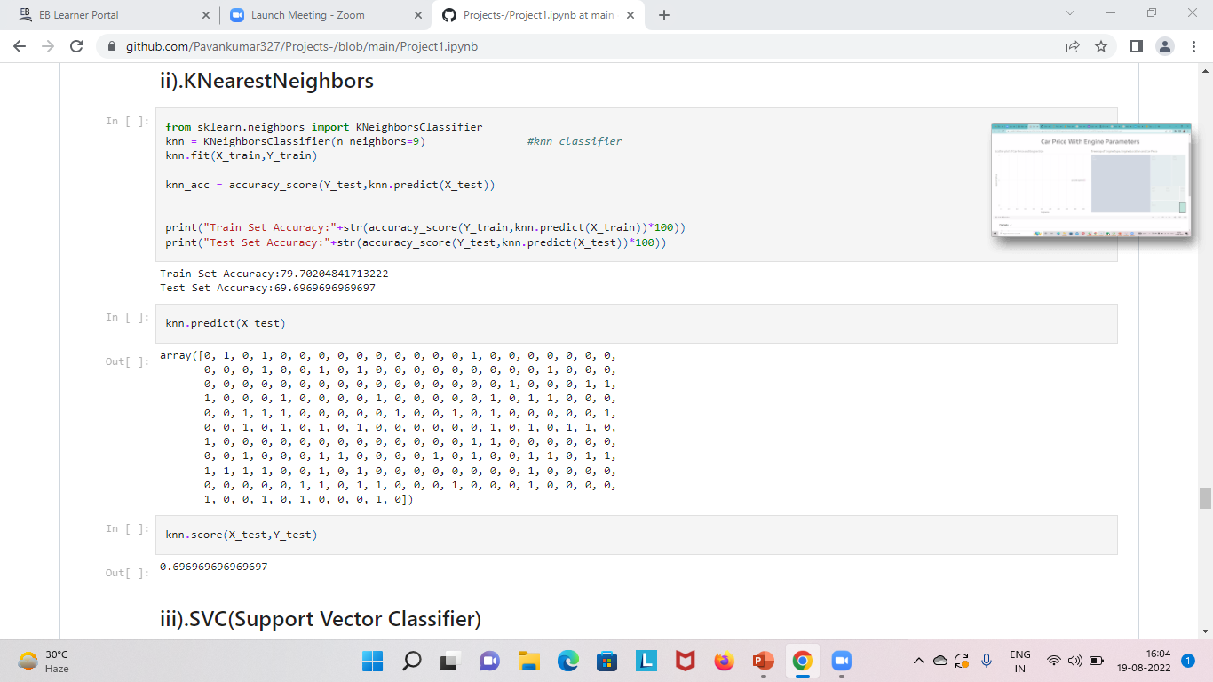
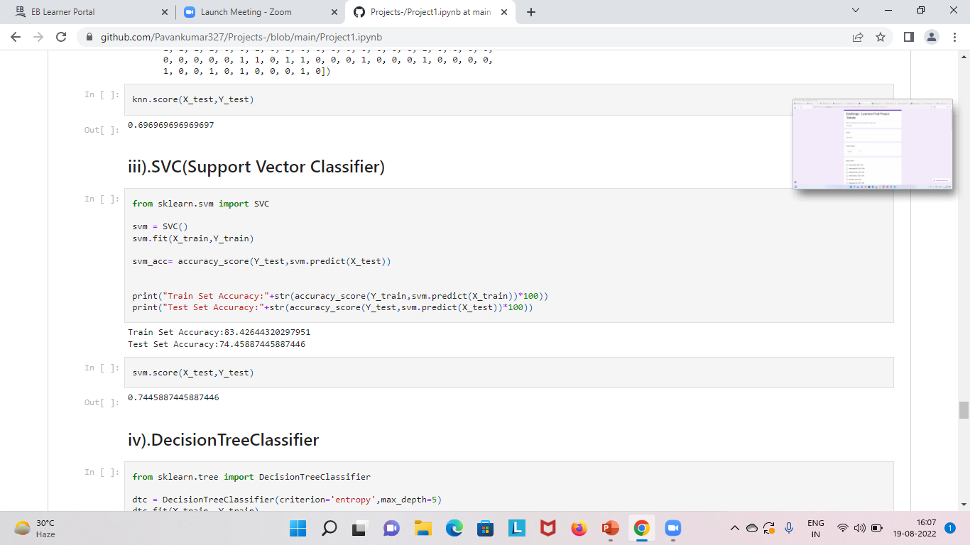

Slide 16
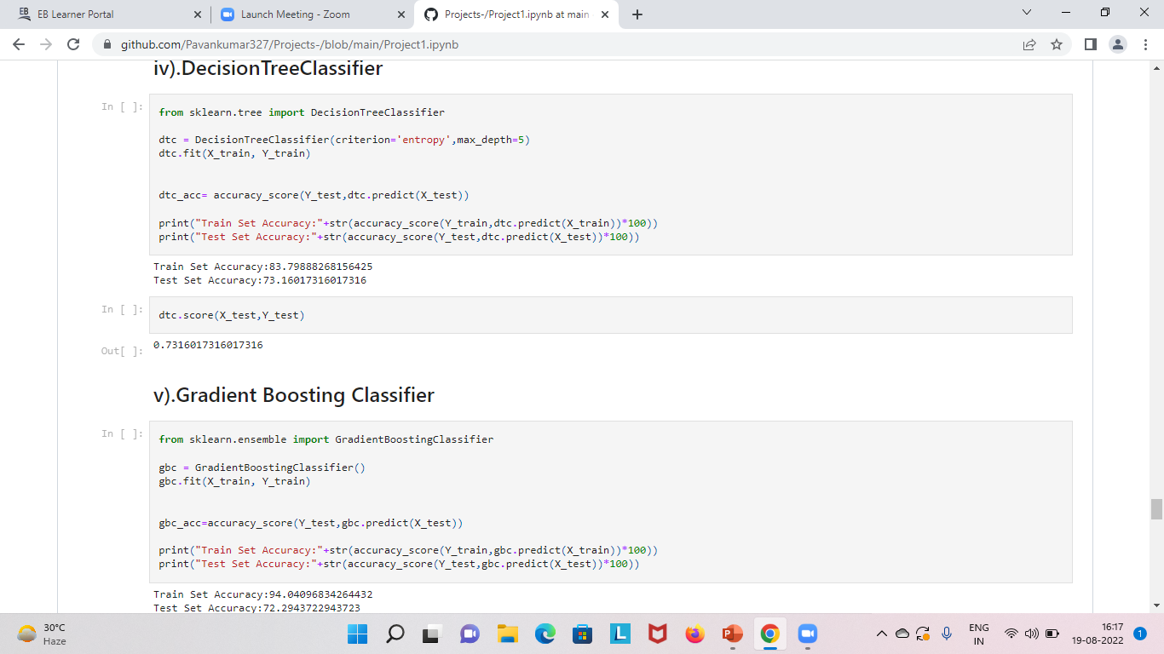

Slide 17
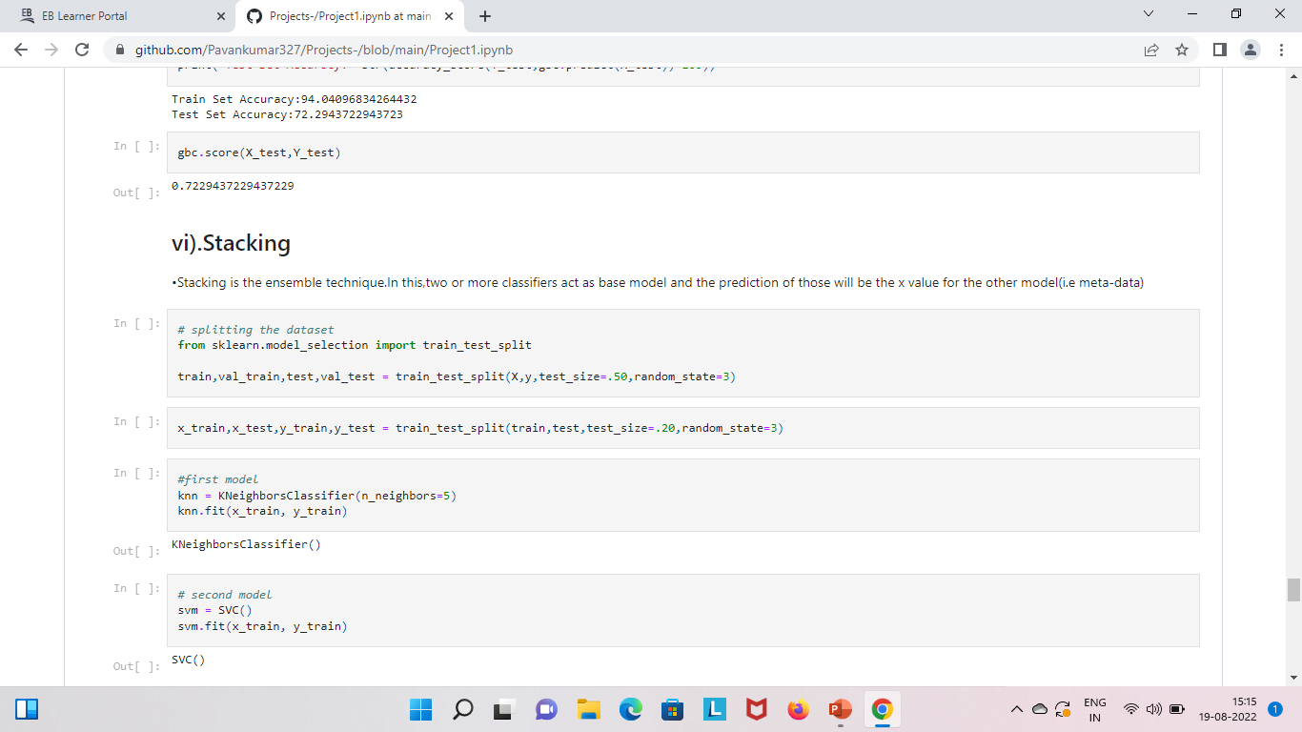

Slide 18
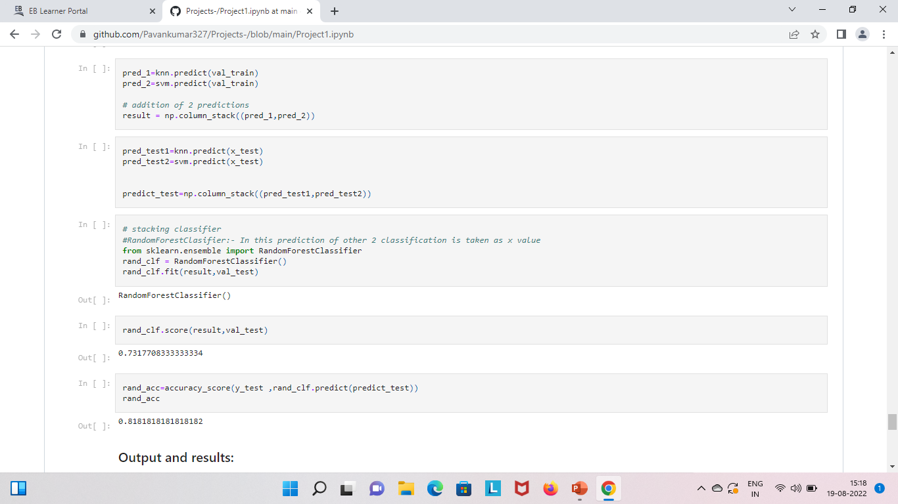

Slide 19
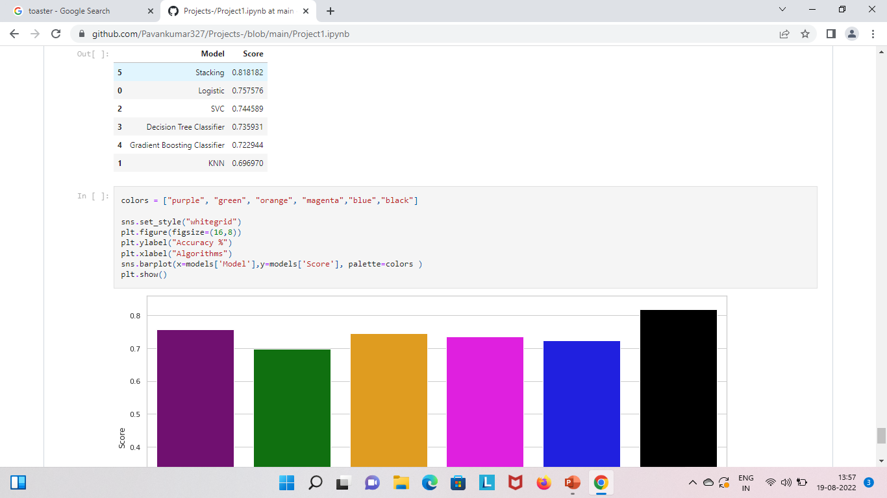
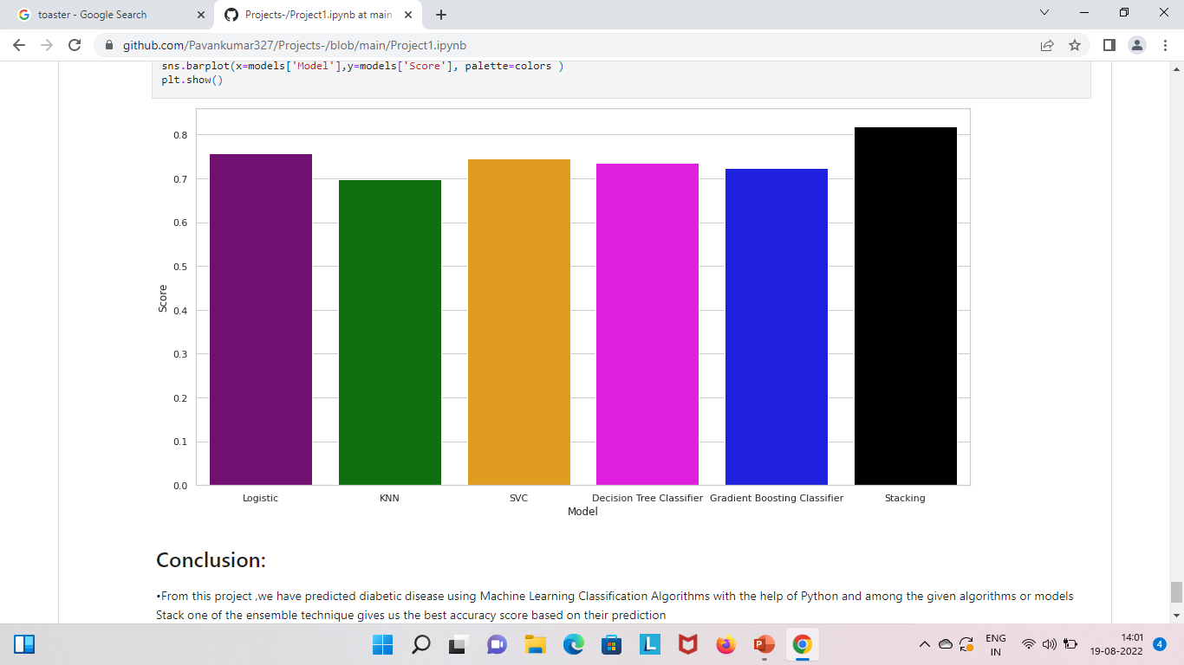
Output values:

Slide 20
Conclusion:
From this project we have predicted people suffering from diabetes disease using multiple Machine Learning models and developed the best intelligent system for prediction based on their accuracy score.
Individually Logistic Regression giving us the best accuracy score about 75% but after using Stacking one of the Ensemble technique giving us accuracy score about 81% in predicting the diabetes disease correctly.
So, we can conclude that Stacking is the best Machine Learning model in predicting the diabetes disease correctly with an accuracy score of 81%.

Slide 21
Thank you Any queries are welcomed

